Slide 1

Federated Learning
Presented by Trong-Binh Nguyen-202388548 Pusan National University
November 9th, 2023

Slide 2
Table of contents
Introduction
Motivations and Applications
Federated Learning
Architecture
Algorithm
Data Acquisition
MNIST
CIFAR-10
Expected Result
Performance

Slide 3
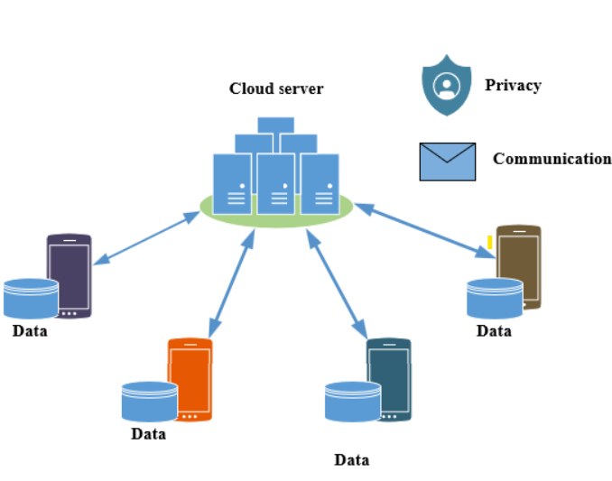
1. Introduction: Motivation and applications
Data Explosion:
The growth of IoT devices
Deep insights of data distribution
Privacy of users and performance
Federated Learning:
Decentralized Learning technique
Provides privacy and good performance
Purpose:
Comparison of performance between Centralized Learning and Federated Learning
Pros and Cons

Slide 4
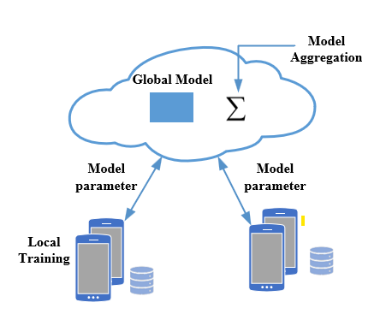
2. Federated Learning: Architecture
Server:
Global model initialization
Receive client model parameters update
Performing optimization based on parameters
Sending back parameters to clients
Clients:
Training based on the local client dataset
Sending model update to the server
Model Architecture:
Server and client share the same model architecture but different parameters
Design model suitable for the tasks
Note:
Only parameters communicated
Performance evaluated for global model

Slide 5
2. Federated Learning: Algorithm
Server Optimization:
Model Averaging
Gradient Conflict Reduction
Clients Optimization:
Clients personalization
domain generalization
→ Enhanced the performance and generalization of Federated Learning
A. Fallah, A. Mokhtari, and A. Ozdaglar, “Personalized federated learning with theoretical guarantees: A model-agnostic meta-learning approach,” in Advances in Neural Information Processing Systems 2020

Slide 6
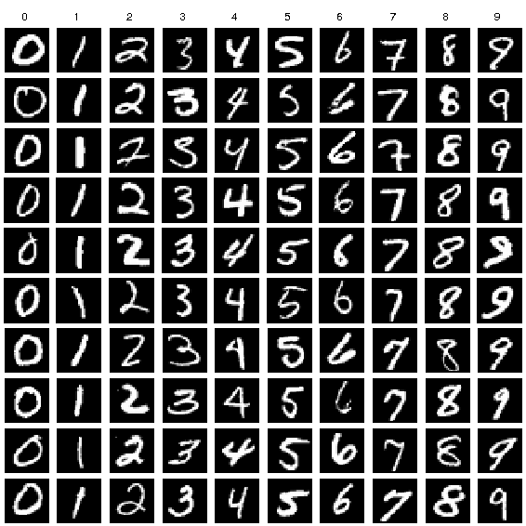
3. Data Acquisition: Mnist
Size and Structure:
MNIST consists of 60,000 training images and 10,000 test images. Each image is a 28x28 pixel square, grayscale, and represents a handwritten digit (0-9)
Handwritten Digits:
The dataset is compiled from scanned handwriting samples, where various individuals wrote digits in a standardized format
Labeled Dataset:
Each image in the dataset is labeled with the corresponding digit it represents, making it a labeled dataset suitable for supervised learning tasks.

Slide 7
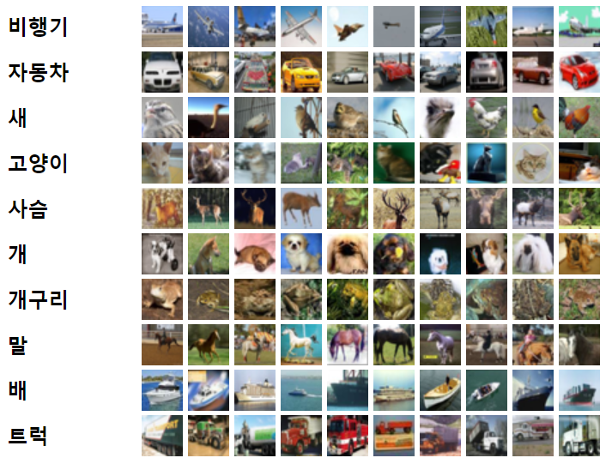
3. Data Acquisition: Cifar-10
Image Categories:
The dataset comprises ten classes: airplanes, automobiles, birds, cats, deer, dogs, frogs, horses, ships, and trucks.
Color Images:
Unlike the MNIST dataset, which contains grayscale images of handwritten digits, CIFAR-10 images are in color, offering a more complex and realistic dataset for training machine learning models.
Balance Distribution:
Each class in the CIFAR-10 dataset contains an equal number of images, totaling 6,000 images per class

Slide 8
4. Expected Results
Performance:
Federated Learning achieved an acceptable performance
Convergence:
Federated Learning converged.
Comparison with Centralized Learning
Performance comparison

Slide 9
QUESTION ^_^

